Slide 1
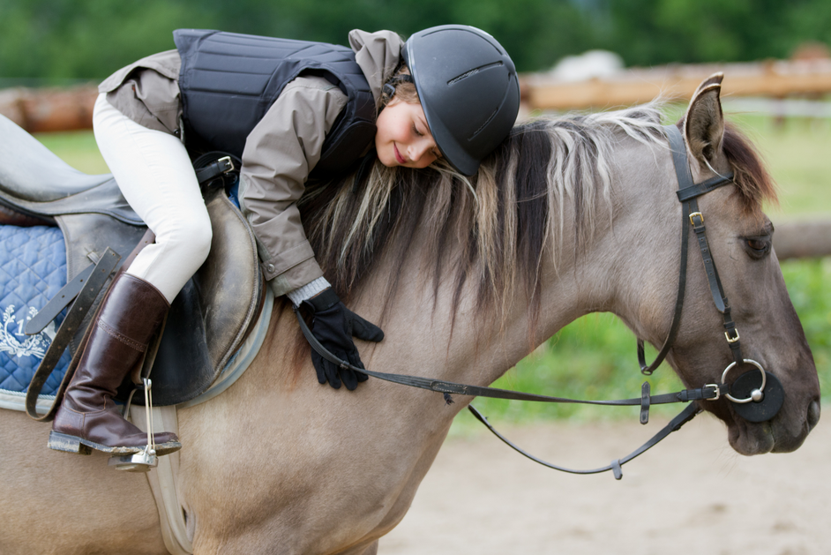
Horse
Health
Monitoring System
[1]
FINAL PRESENTATION
Senior Design I – Spring 2017
Notes:
Presenter: Sandy

Slide 2
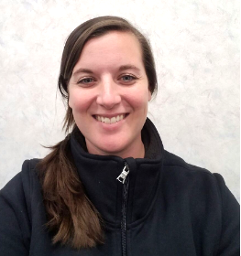
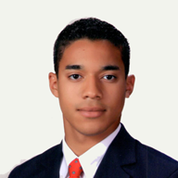
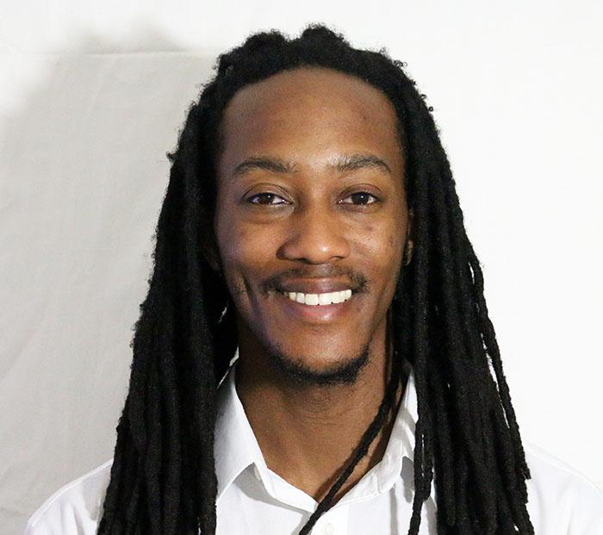
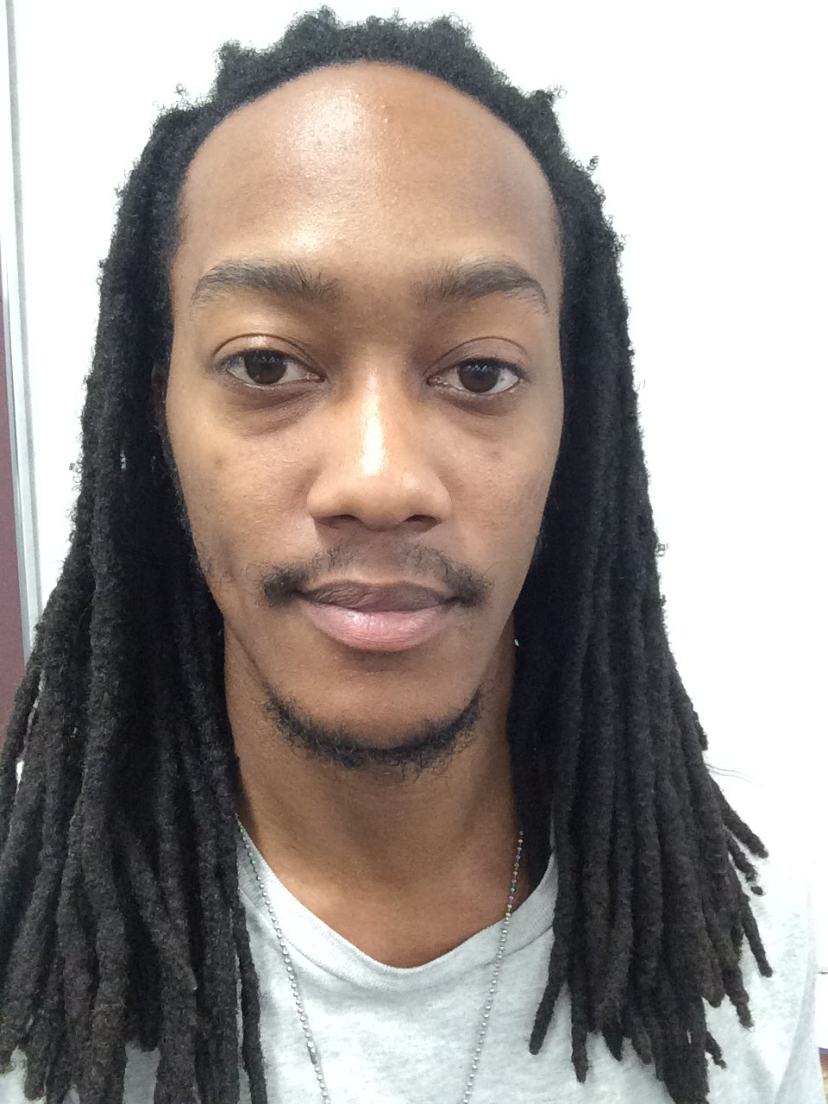
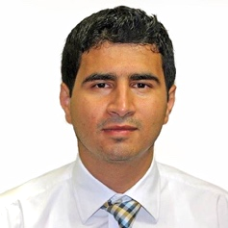
TEAM MEMBERS
Casandra Sasser
Electrical Engineering
Team Leader
System and Enclosure Design
Austin Heath
Computer Engineering
GSM Programming/ Communications
Jeremy Brown
Electrical Engineering
Temperature Sensor Design/Testing
Hussein Alsabbahi
Electrical Engineering
Pulse Sensor Design/Testing
Notes:
Presenter: Sandy

Slide 3
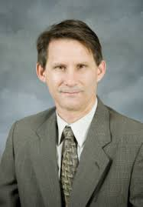
ADVISOR
Dr. Robert B. (Bob) Reese
Associate Professor and Robert D. Guyton Chair for Teaching Excellence
Education
Ph.D., Texas A&M University, 1985
M.S., Texas A&M University, 1982
B.S., Louisiana Tech University, 1979
Interests/Hobbies
Computer Architecture / VLSI
MSU Anime Club faculty advisor
Cat Rescue Operations
[2]
Notes:
Presenter: Sandy

Slide 4

AGENDA
Problem & Solution
System Overview
Constraints
Technical
Practical
System Testing
Timeline
Progress
Questions
Notes:
Presenter: Sandy

Slide 5
PROBLEM
&
SOLUTION
Notes:
General Transition

Slide 6
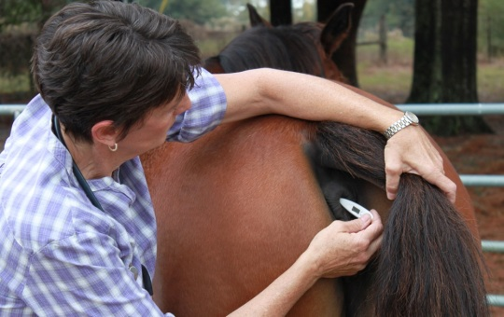
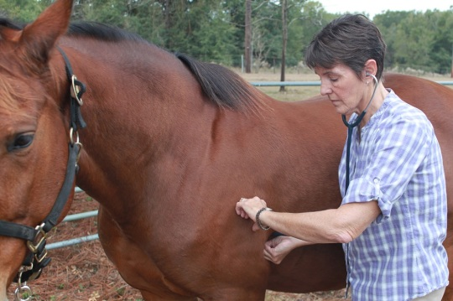
PROBLEM
Horse owners and veterinarians need:
Affordability
Efficiency
Safety
Responding to signs of illness in a horse automatically may reduce:
Injury
Death
[3]
Notes:
Presenter: Sandy

Slide 7

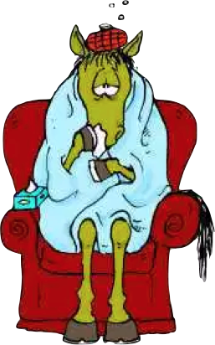
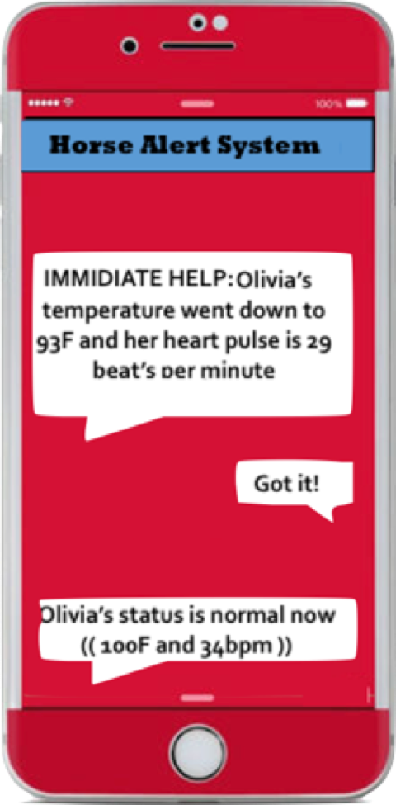

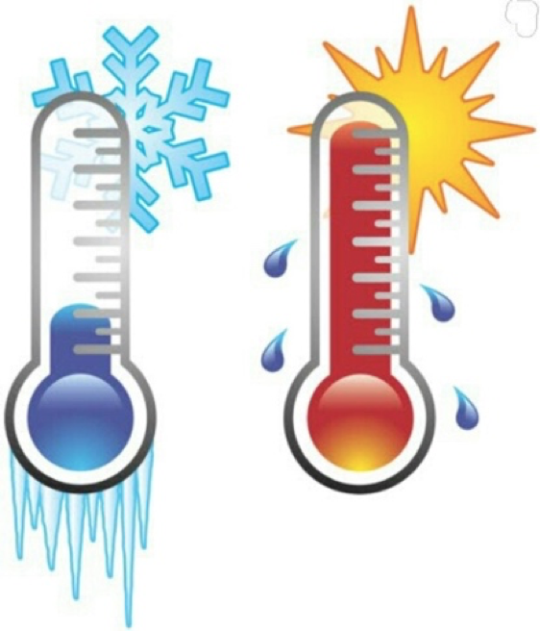
SOLUTION
Horse Health Monitoring System:
Accurate measurement of temperature and pulse
User-set time intervals for data collection
Data transmitted to user via SMS
[4]
[4-8]
Notes:
Presenter: Sandy

Slide 8
SYSTEM
OVERVIEW
Notes:
General Transition

Slide 9
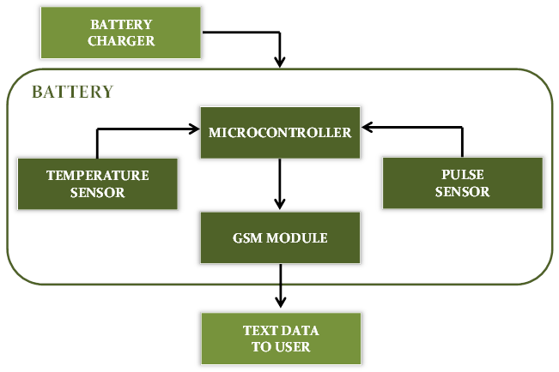
SYSTEM OVERVIEW
Notes:
Presenter: Sandy

Slide 10
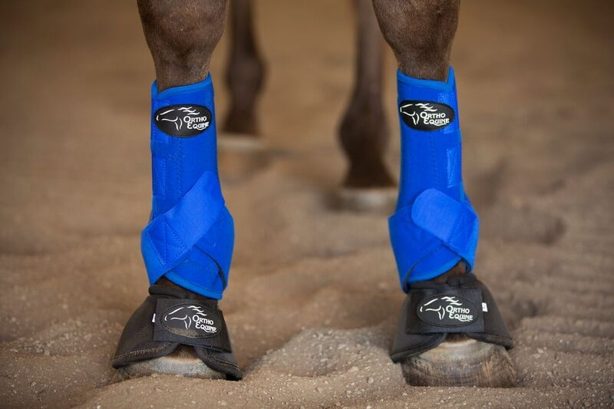
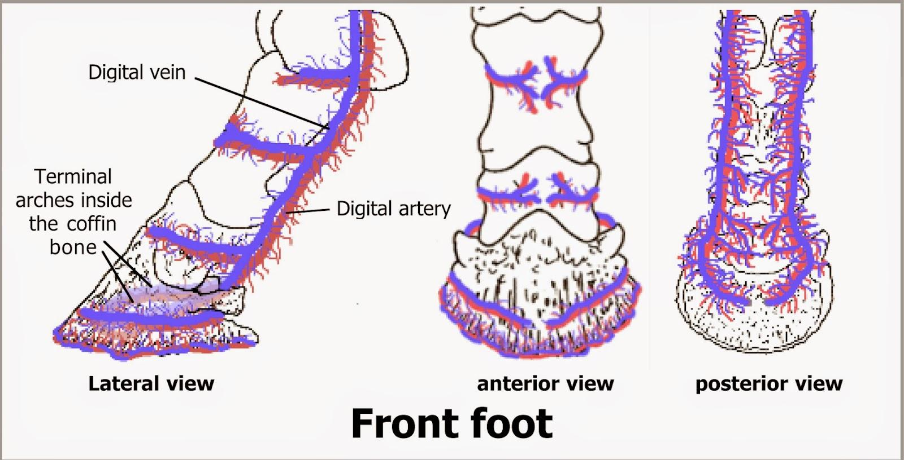
SYSTEM OVERVIEW
[9-10]
Notes:
Presenter: Sandy

Slide 11
CONSTRAINTS
Notes:
General Transition

Slide 12
TECHNICAL CONSTRAINTS
Constraint | Description
Temperature Sensor Accuracy | Range: 90˚F to 110˚F ± 1˚F of rectal temperature
Pulse Sensor Accuracy Ingress Protection | Range: 25 to 200 bpm Rating: IP56
Notes:
Presenter: Austin

Slide 13
TECHNICAL CONSTRAINTS
Constraint | Description
Battery Life | Minimum 12 hrs operation
User Notifications | Update user at predefined intervals via SMS messages
Notes:
Presenter: Austin

Slide 14
PRACTICAL CONSTRAINTS
Type | Name | Description
Health | Safety | Cannot be hazardous or invasive to horses
Manufacturability | Size | Must fit various horse sizes; compact
Notes:
Presenter: Dee

Slide 15
SYSTEM
TESTING
Notes:
General Transition

Slide 16
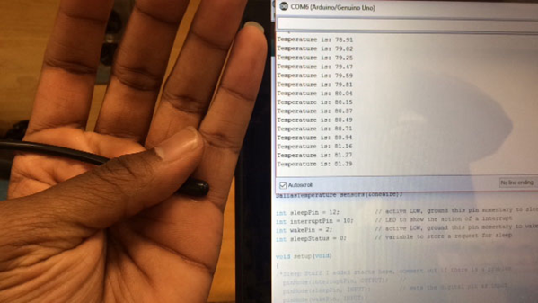
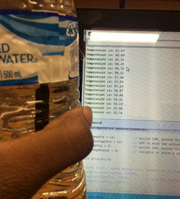
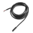
TEMPERATURE SENSOR
Laboratory Testing
DS18B20
Digital
Probe
[11]
Notes:
Presenter: Dee

Slide 17
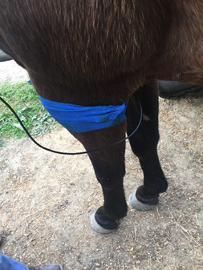
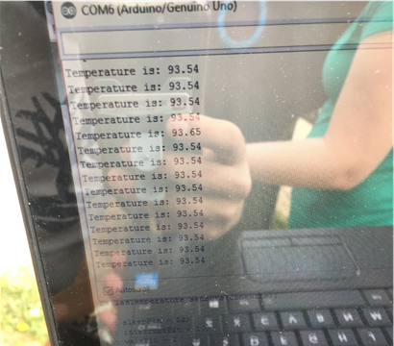
TEMPERATURE SENSOR
Field Testing
Notes:
Presenter: Dee

Slide 18
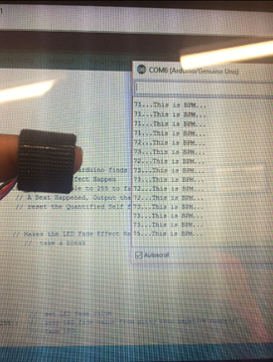
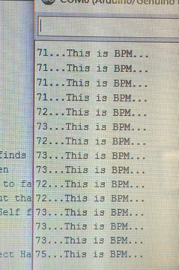
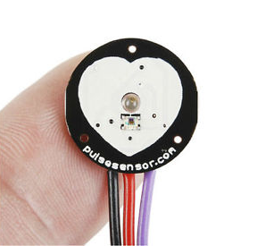
PULSE SENSOR
Laboratory Testing
Pulse
Sensor
Amped
[12]
Notes:
Presenter: Hussein

Slide 19
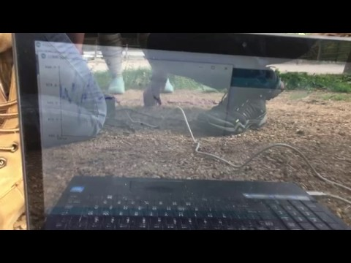
PULSE SENSOR
Field Testing
Notes:
Presenter: Hussein

Slide 20
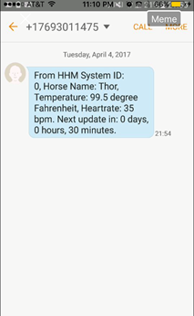
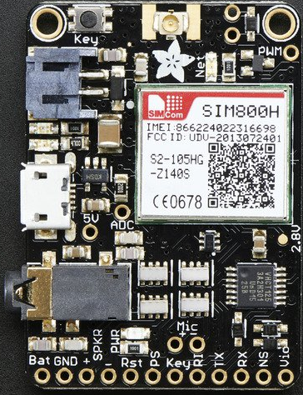
GSM Module
Adafruit
FONA
MiniGSM
SIM800H
[13]
Notes:
Presenter: Austin

Slide 21
TIMELINE
&
PROGRESS
Notes:
General Transition

Slide 22
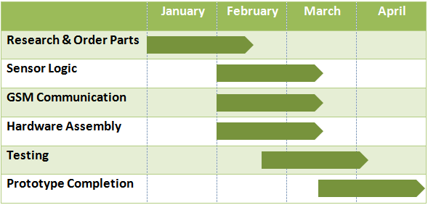
TIMELINE
Notes:
Presenter: Hussein

Slide 23
PROGRESS
Temperature sensor - field test completed
Pulse sensor - laboratory test completed, partial field tested
GSM module - send and receive functions complete
Notes:
Presenter: Hussein

Slide 24
FUTURE WORK
Temperature sensor - calibrate offset from rectal temp
Pulse sensor - complete field testing
GSM module - program appropriate interrupts
Notes:
Presenter: Hussein

Slide 25
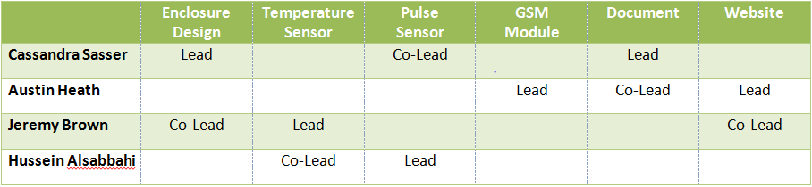
TEAMING
Notes:
Presenter: Hussein

Slide 26
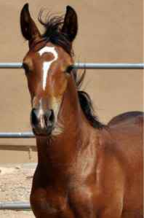
QUESTIONS
[14]
Notes:
Presenter: Hussein

Slide 27
REFERENCES
[1] Horse Muscle Care,. Girl With Horse. n.d. [Online]. Available: http://horsemusclecare.com/wp-content/uploads/2010/04/Dollarphotoclub_50123119.jpg [Accessed: Mar. 2, 2017].
[2] Satish Kashyap. Dr. Robert Reese. n.d. [Online]. Available:http://www.satishkashyap.com/2012/02/lecture-material-ppts-on-introduction.html [Accessed: Mar. 5, 2017].
[3] Dr. Tanhauser, Susan. Learning to Take Your Horse’s Vital Signs. n.d. [Online]. Available: http://www.northfloridaequine.com/vital-signs/ [Accessed: Apr. 11, 2017].
[4] David Ramey. DVM. sick_horse_cartoon[1]. 2012. [Online]. Available: http://www.doctorramey.com/fevers/ [Accessed: Mar. 5, 2017].
[5] OM Hospital. ICU. n.d. [Online]. Available: http://www.omhospital.org/ [Accessed: Mar. 5, 2017].
[6] Hvacservices. HVAC Heating. 2014. [Online]. Available: http://hvacservices.livejournal.com/1351.html [Accessed: Mar. 5, 2017].
[7] DecalGirl. Solid State Red. n.d. [Online]. Available:
https://www.decalgirl.com/skins/316276/apple-iphone-7-plus-skin-solid-state-red [Accessed: Mar. 5, 2017].

Slide 28
REFERENCES
[8] ColourBox. Funny horse cartoon. n.d. [Online]. Available: https://www.colourbox.com/vector/funny-horse-cartoon-vector-7181395 [Accessed: Mar. 5, 2017].
[9] https://www.valleyvet.com/ct_detail.html?pgguid=6f367bda-c634-4a93-9b3f-611b3ce8b26b
[10] http://mink-studios.blogspot.com/2015/03/steppin-out-hooves-from-artistic_28.html
[11] SparkFun. Temperature Sensor - Waterproof (DS18B20). n.d. [Online]. Available: https://www.sparkfun.com/products/11050 [Accessed: Mar. 5, 2017].
[12] Pulse Sensor. PulseSensorAmpedFinger-web_2. n.d. [Online]. Available: https://pulsesensor.com/products/pulse-sensor-amped [Accessed: Mar. 5, 2017].
[13] Adafruit. 1946-06. n.d. [Online]. Available: https://www.adafruit.com/products/1946 [Accessed: Mar. 5, 2017].
[14] DriftwoodsQHs, Senior Member. Clyde/Arab. 2011. [Online]. Available: http://myhorseforum.com/threads/wierd-face-markings-post-away.327670/page-45#post6084330 [Accessed: Mar. 2, 2017].

